Slide 1

Flight Delay
Ahmad
Nathanael

Slide 2

OBJECTIVE
PREDICTING FLIGHT DELAYS
CLASSIFYING DELAYS
PREDICTING CANCELLED FLIGHTS

Slide 3
SECTIONS
VISUALIZATION
FEATURE ENGINEERING
MODEL BUILDING
RESULTS

Slide 4
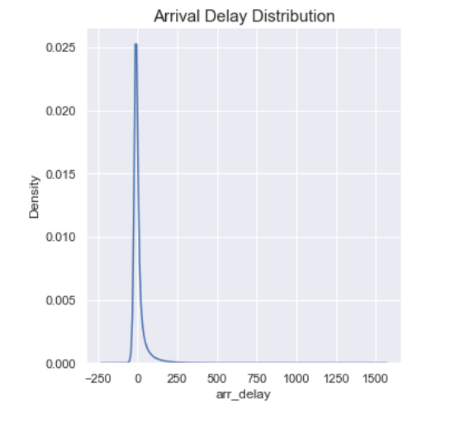
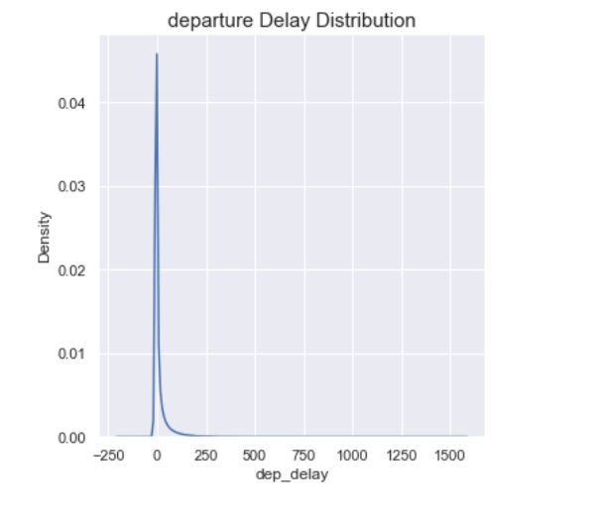
VISUALIZATION
ARRIVAL AND DEPARTURE DELAY DIST BEFORE DEALING WITH OUTLIERS

Slide 5
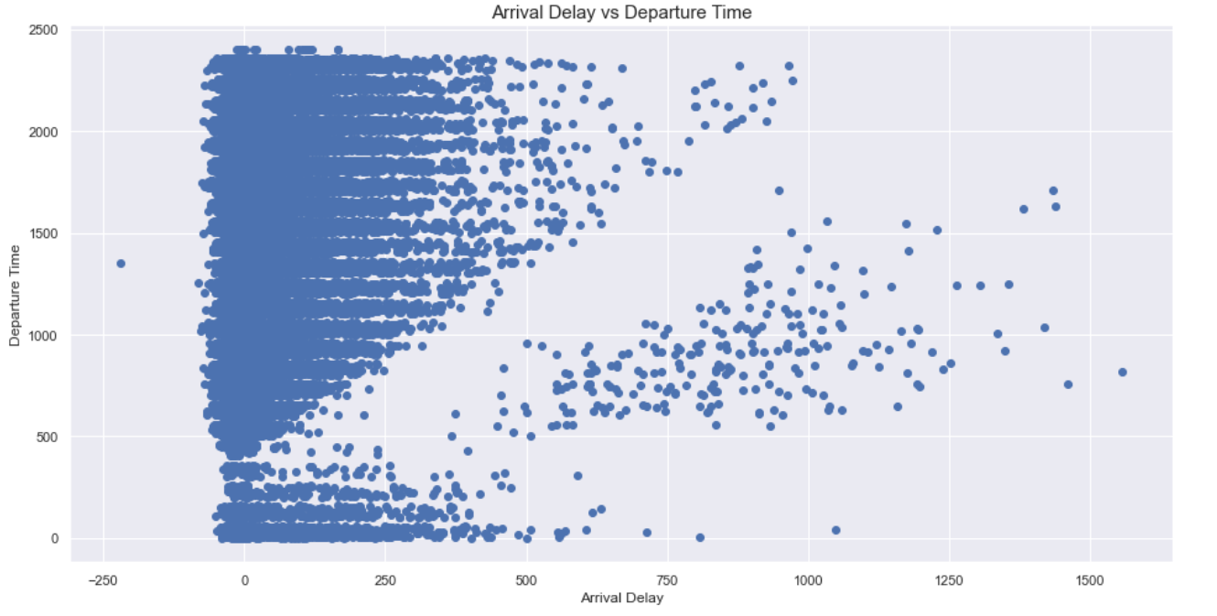
ARRIVAL DELAY OUTLIERS

Slide 6
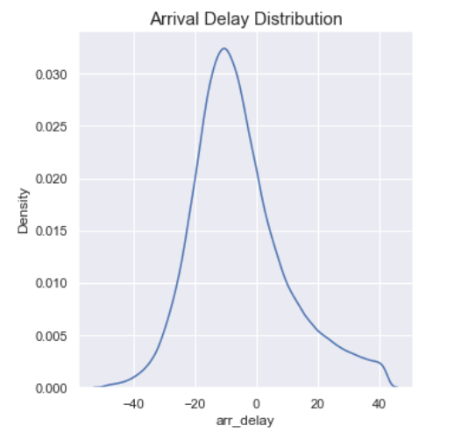
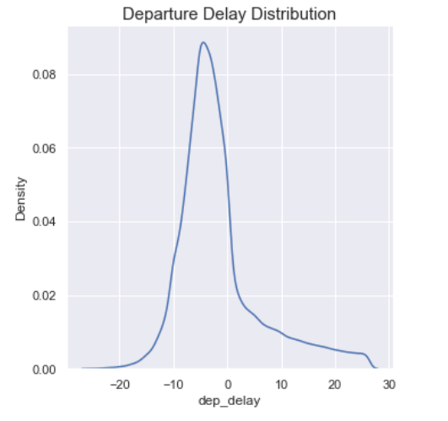
DISTRIBUTION AFTER REMOVING OUTLIERS

Slide 7
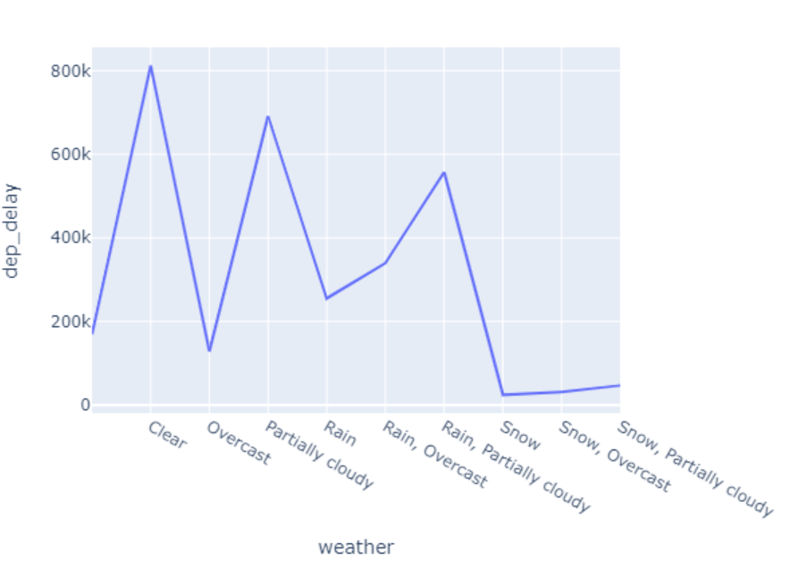
WEATHER AND DEPARTURE DELAY

Slide 8
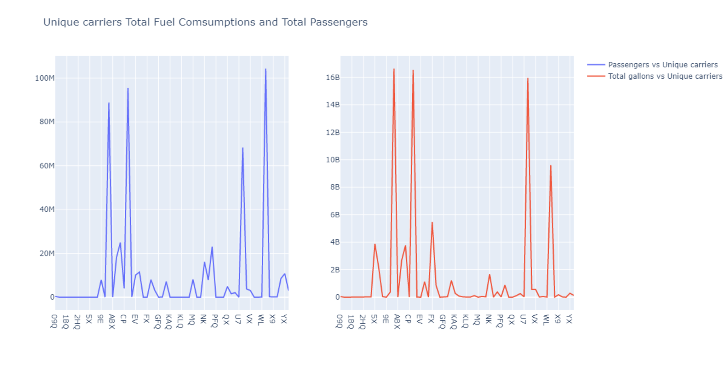
PASSENGERS AND FUEL CONSUMPTION

Slide 9
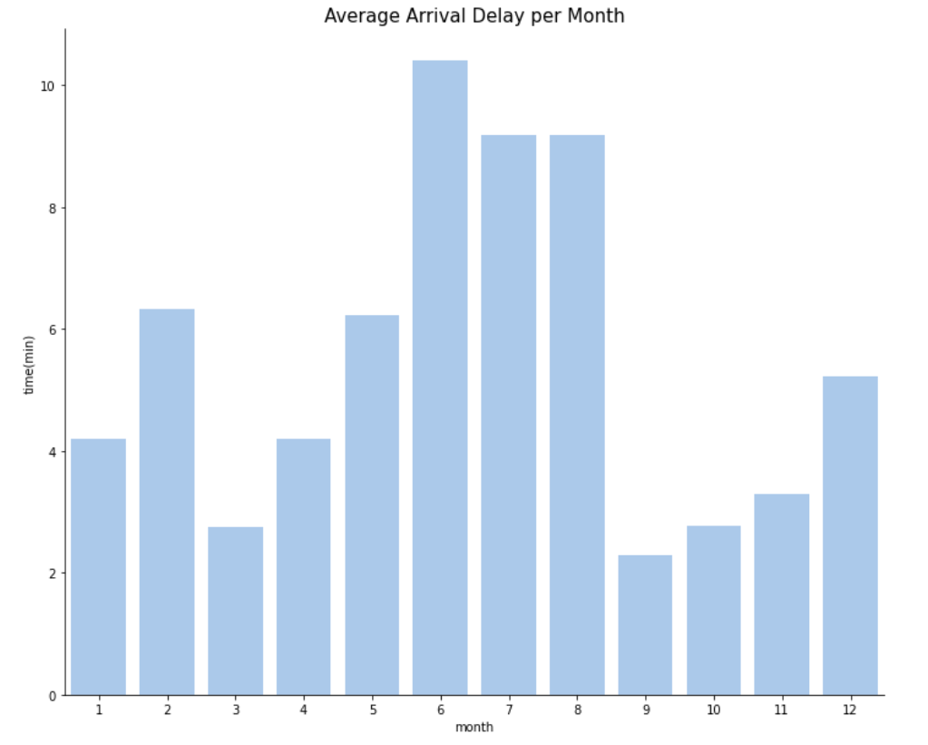
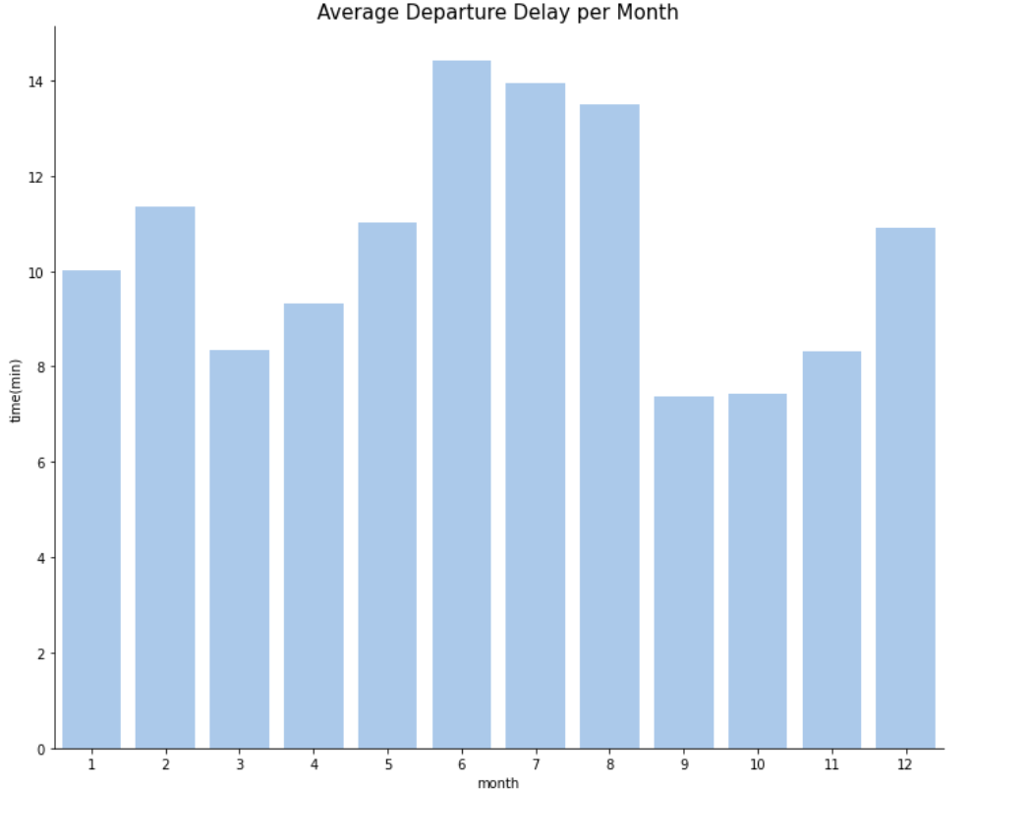
AVERAGE ARRIVAL AND DEPARTURE PER MONTH

Slide 10
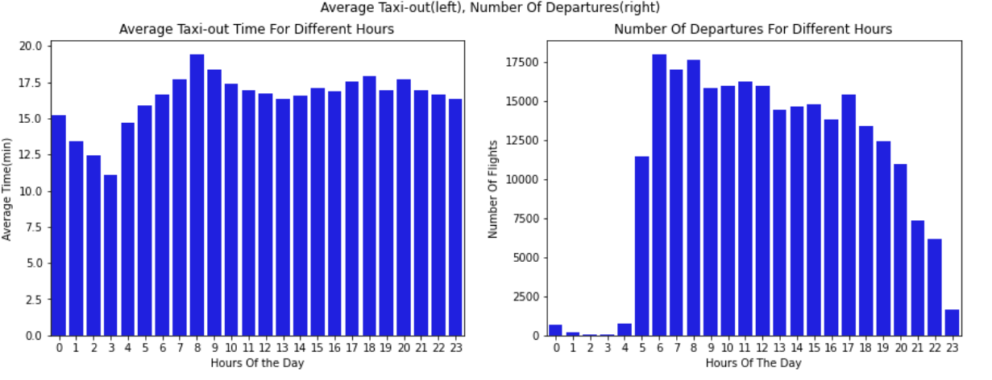
AIR TRAFFIC IN DIFFERENT HOURS OF THE DAY

Slide 11
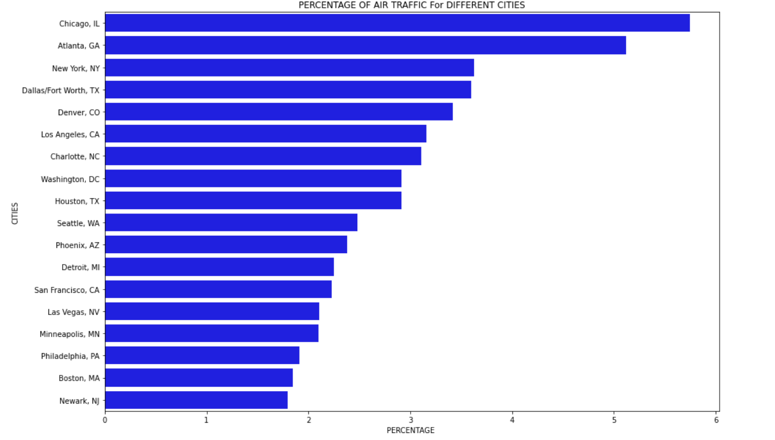
PERCENTAGE OF AIR TRAFFIC FOR TOP CITIES

Slide 12
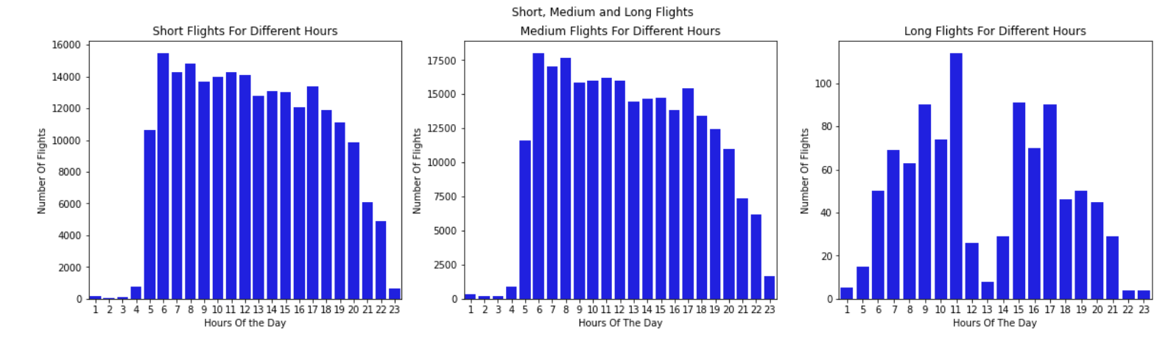
DIFFERENT FLIGHT TYPES

Slide 13
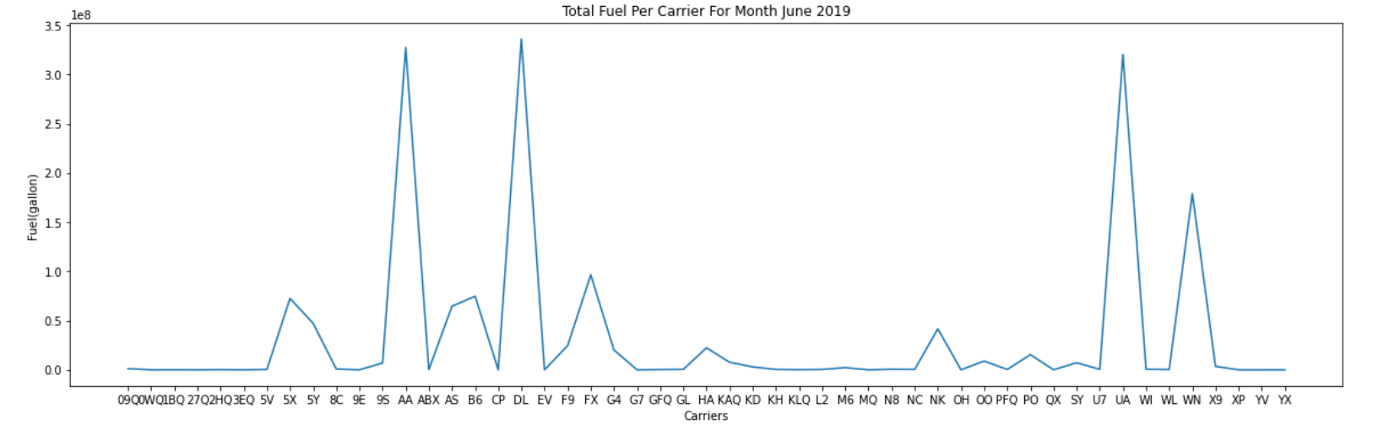
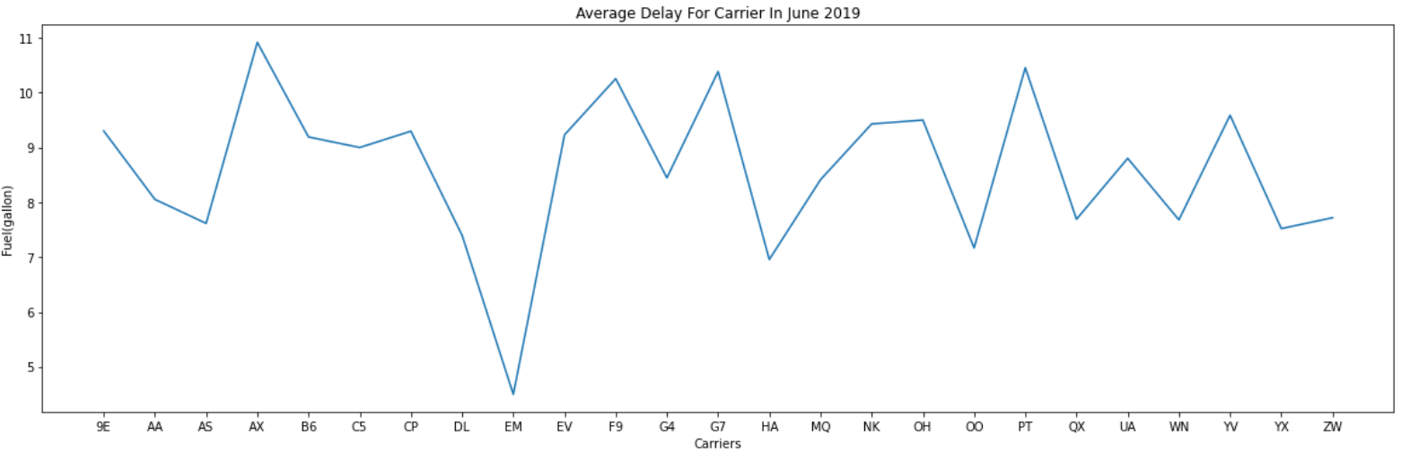
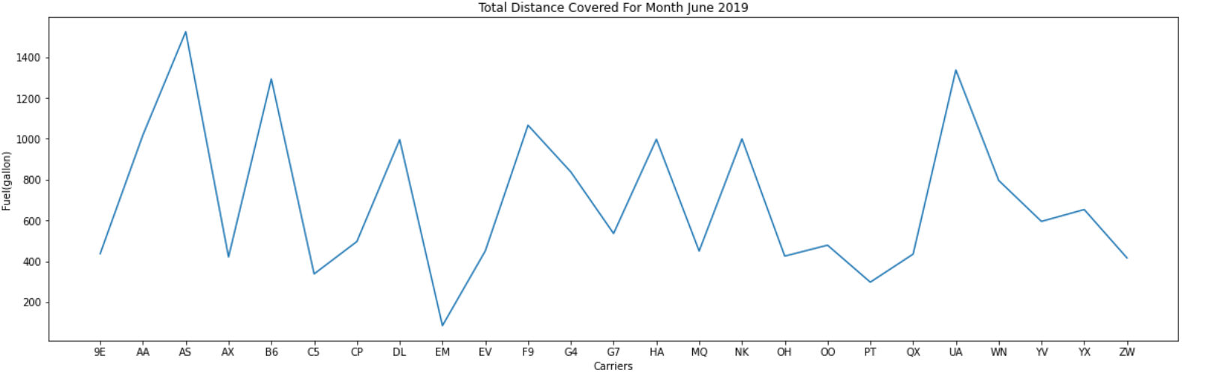
FUEL AND DELAYS

Slide 14

FEATURE ENGINEERING AND MODEL BUILDING
HIGH DIMENSION
LOW R SQUARED SCORE
VERY LOW MEAN SQAURED ERROR
HIGHLY IMBALANCE

Slide 15


Slide 16

FEATURE ENGINEERING
USING DIFFERENT FEATURES
DESTINATION
ARRIVAL TIME
MKT_CARRIER_UNIQUE
TAXI_IN
HOUR OF THE DAY
MONTH OF THE YEAR
SORTING THE VALUES BY YEAR
ELAPSED TIME

Slide 17

MODELING

Slide 18
MODELLING
RIDGE REGRESSION WITH CROSS VALIDATION
XGBOOST REGRESSION
RANDOM FOREST
XGBOOST CLASSIFIER

Slide 19
SAMPLING
UNDERSAMPLING
SMOTE
BOOTSTRAP

Slide 20

EVALUATION METRICS
R SQUARED SCORE
ROOT MEAN SQUARED ERROR
ACCURACY
RECIEVER OPERATING CHARACTERISTIC
F SCORE

Slide 21
RESULTS

Slide 22
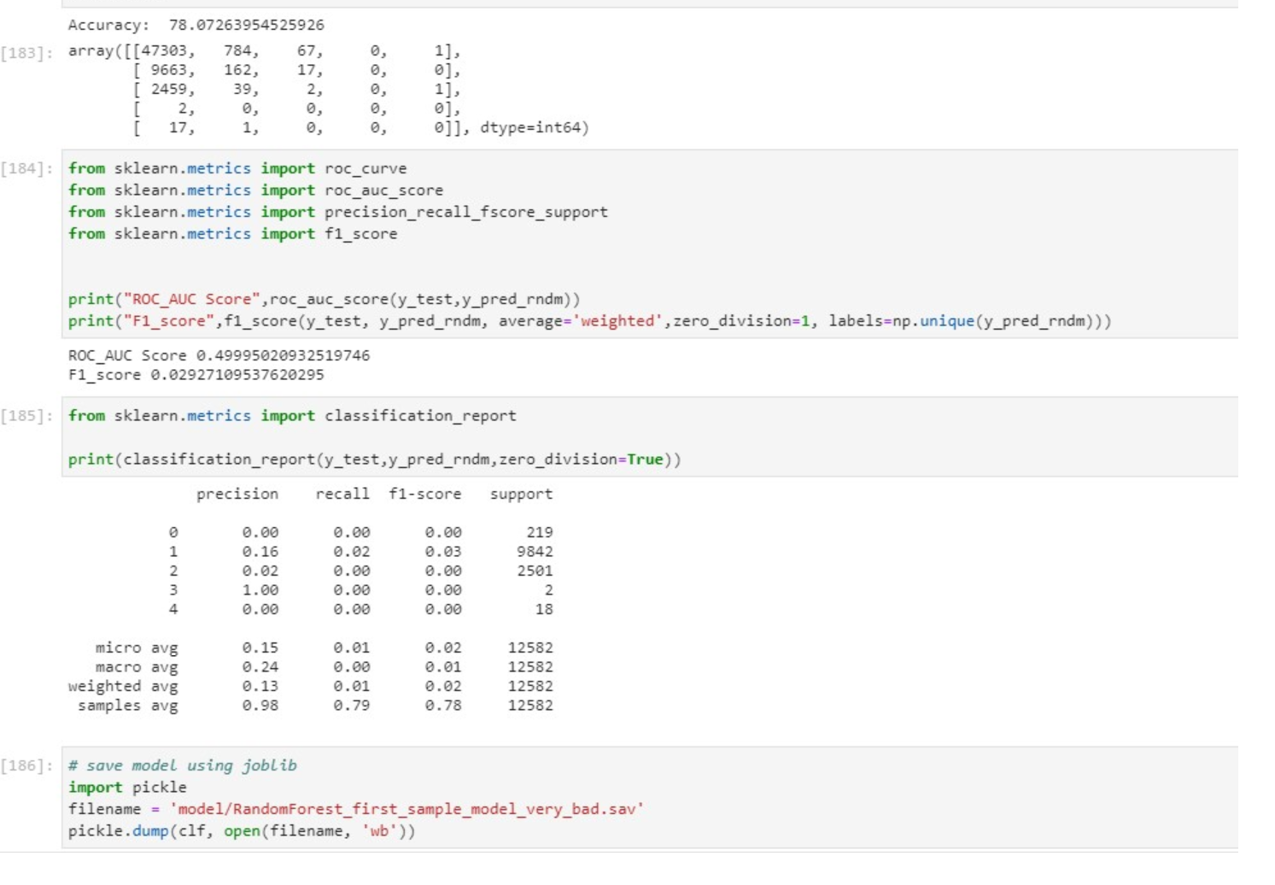
RANDOM FOREST

Slide 23
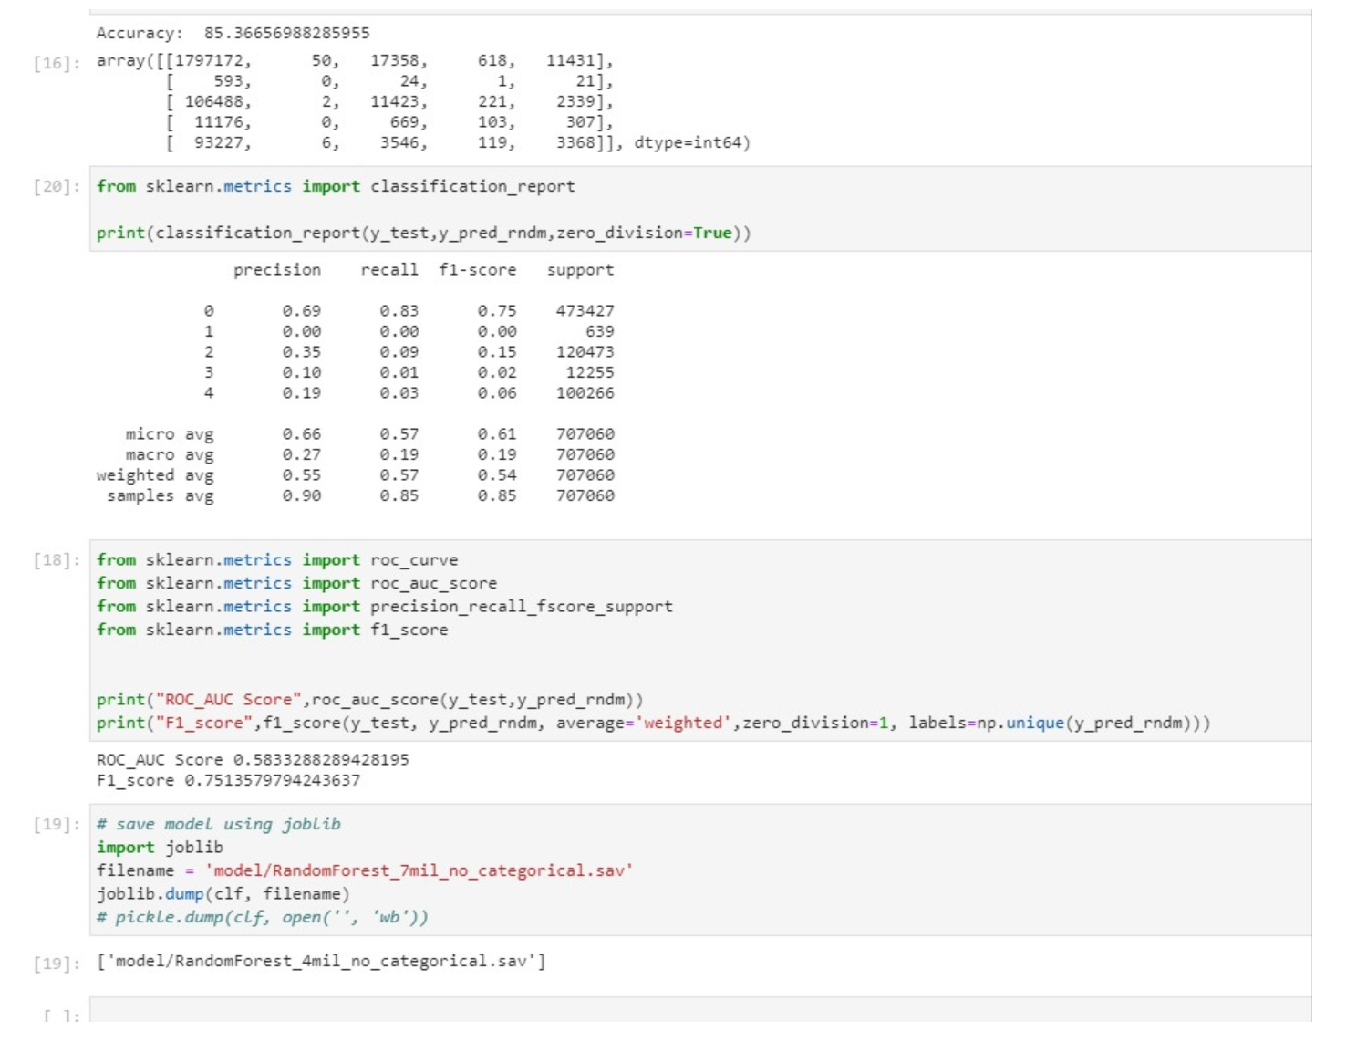
RANDOM FOREST

Slide 24
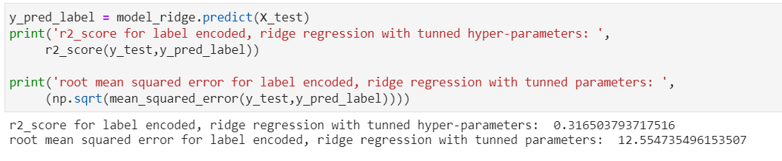
RIDGE REGRESSION (LABEL ENCODED)

Slide 25
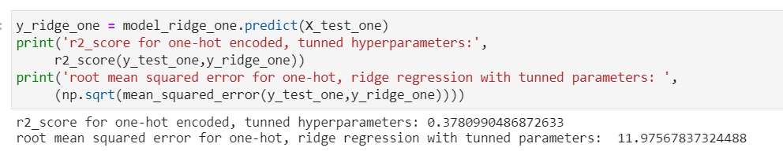
RIDGE REGRESSION(ONE-HOT)

Slide 26
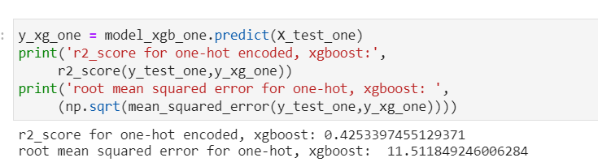
XGBOOST REGRESSION(ONE HOT)

Slide 27
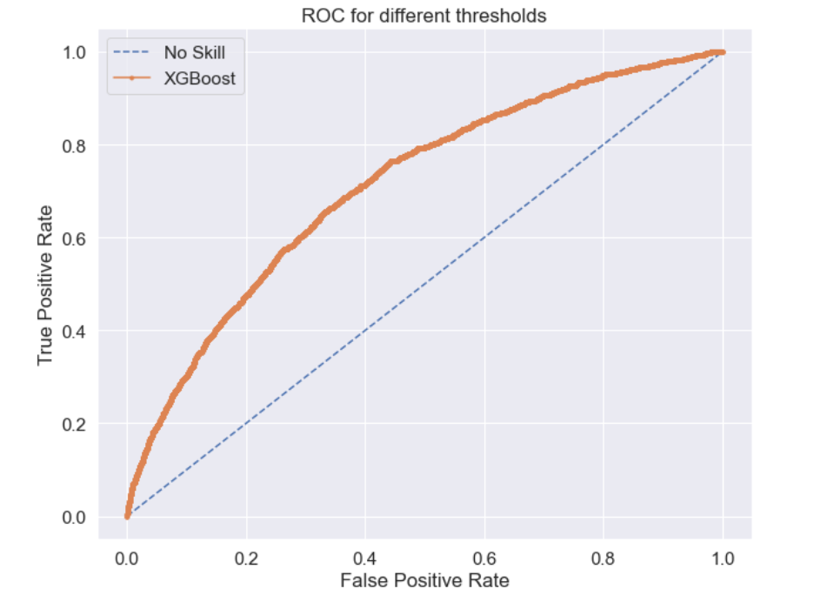
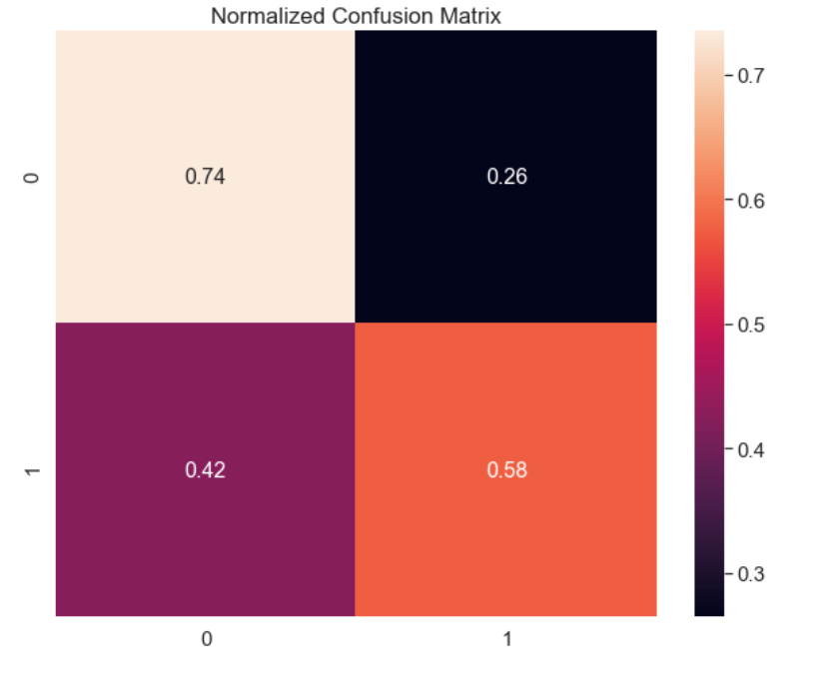
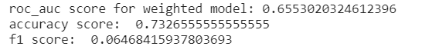
XGBOOST CLASSIFIER(WITHOUT SMOTE)

Slide 28
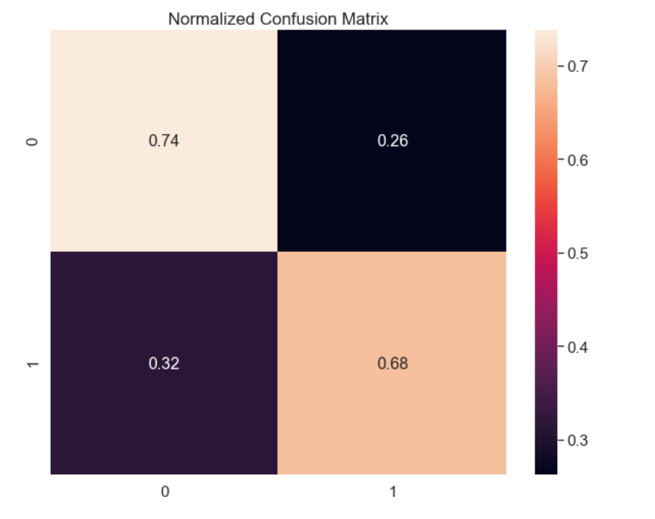
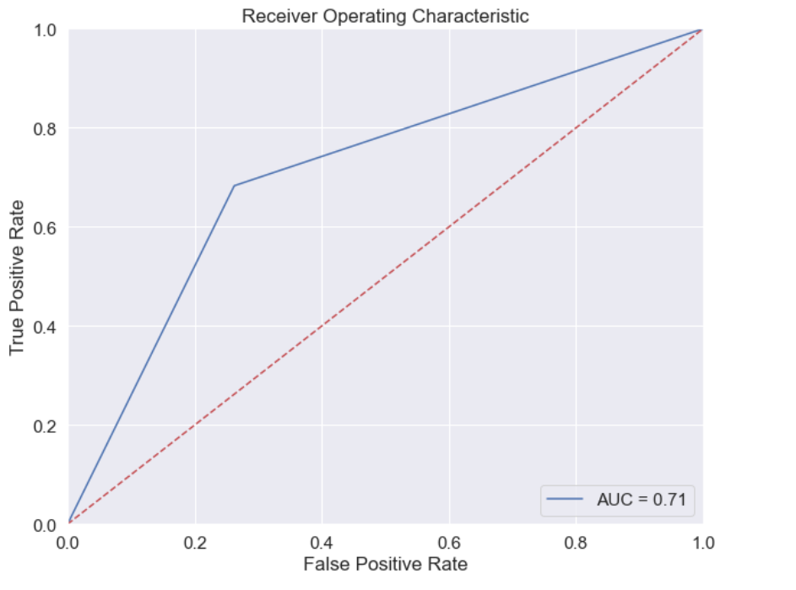
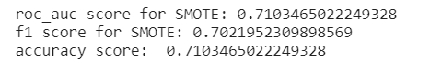
XGBOOST (WITH SMOTE)

Slide 29

BIGGEST CHALLENGE
Data imbalance
PRODUCTION

